Slide 1


Slide 2
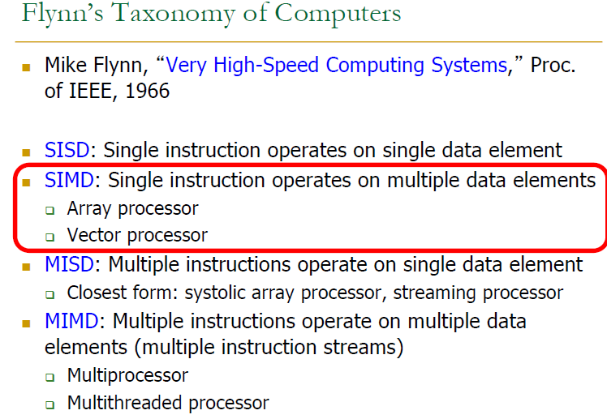

Slide 3
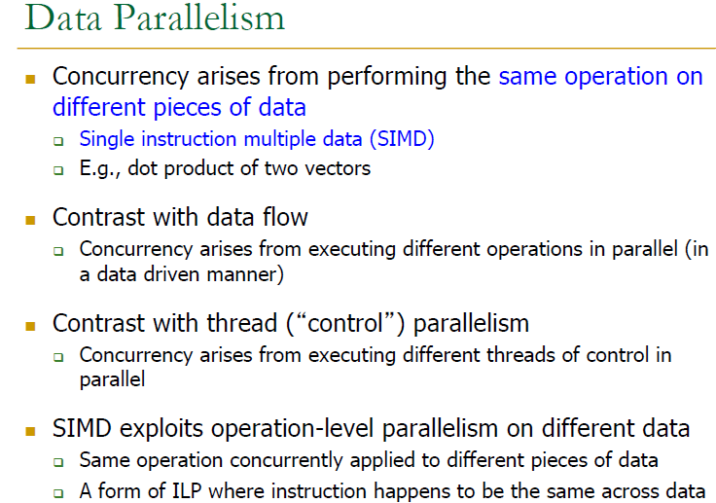

Slide 4
Instruction Level Parallelism
Data Level Parallelism
Thread Level Parallelism

Slide 5
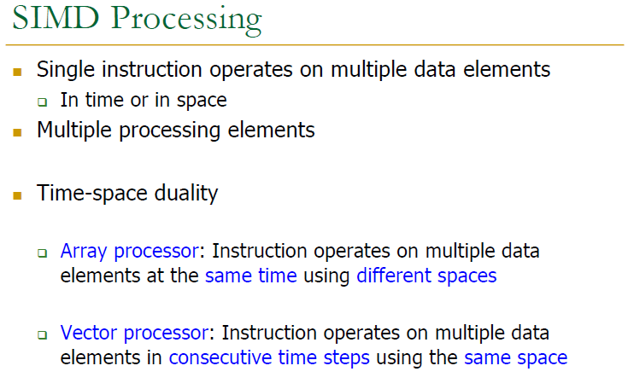

Slide 6
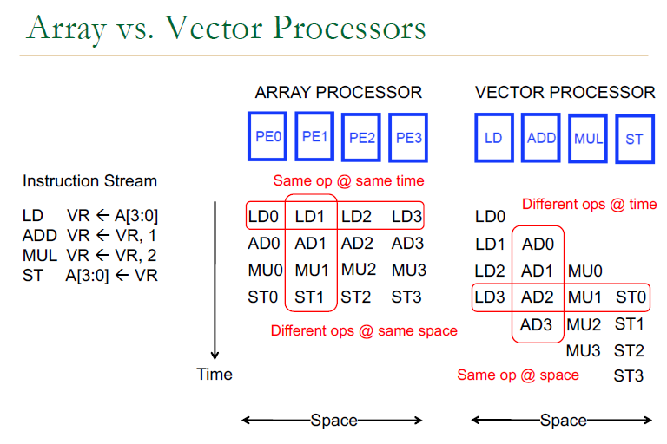

Slide 7
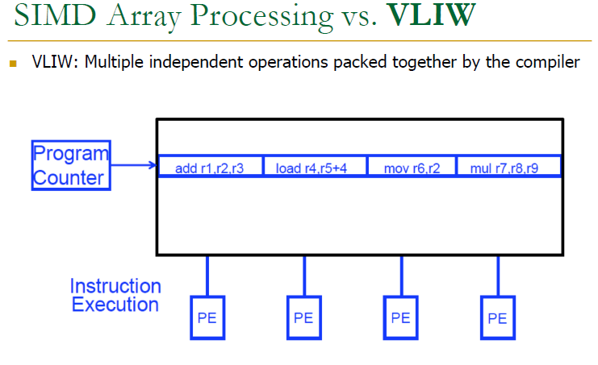

Slide 8
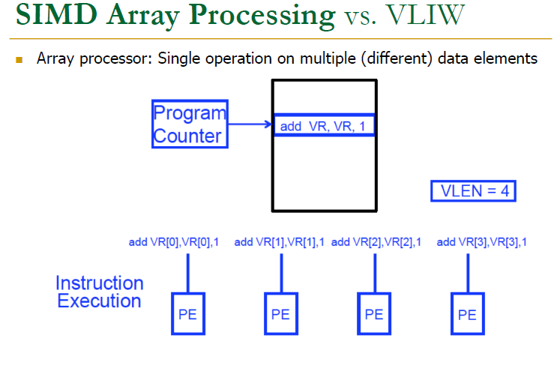

Slide 9
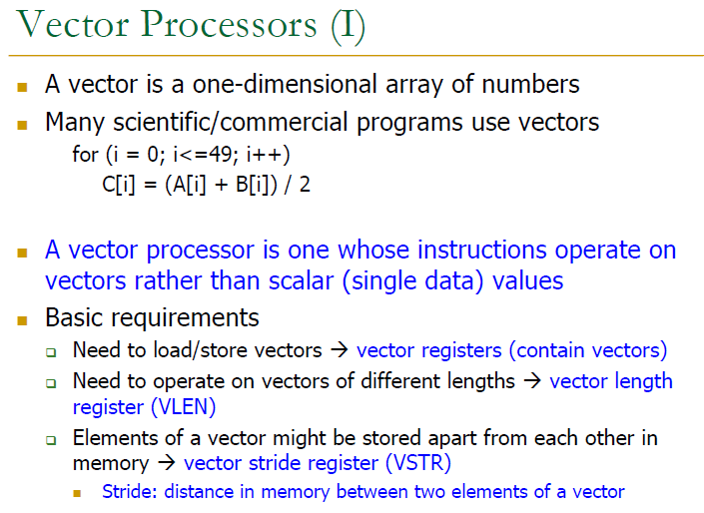

Slide 11
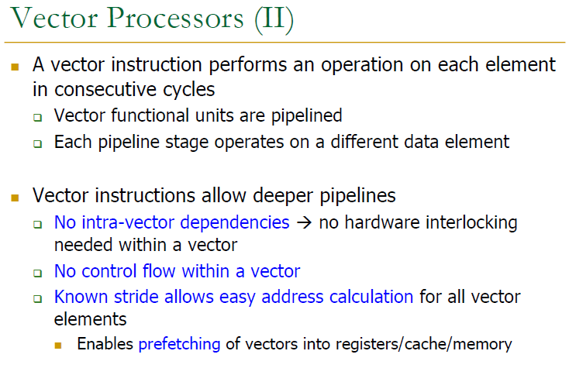

Slide 14
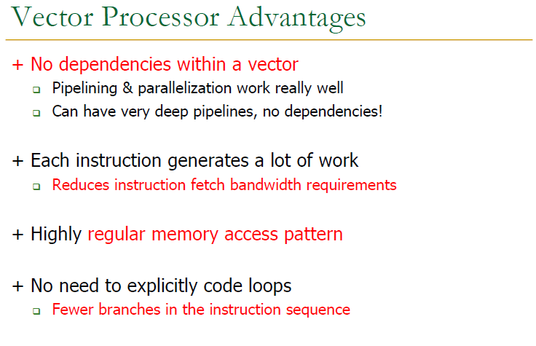

Slide 15
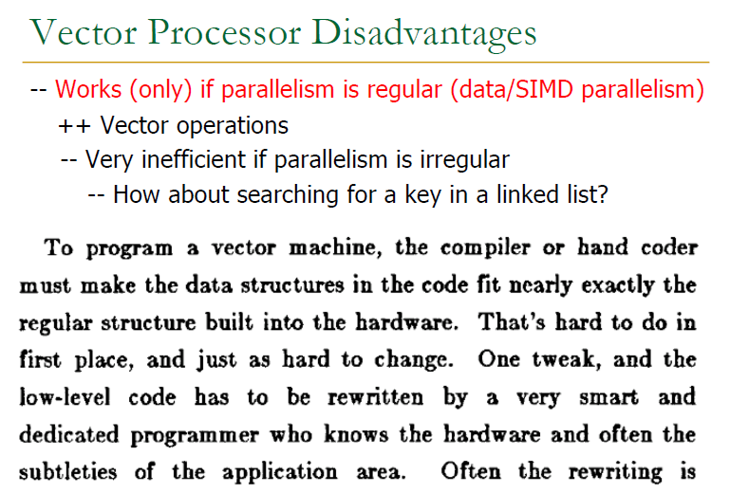

Slide 16
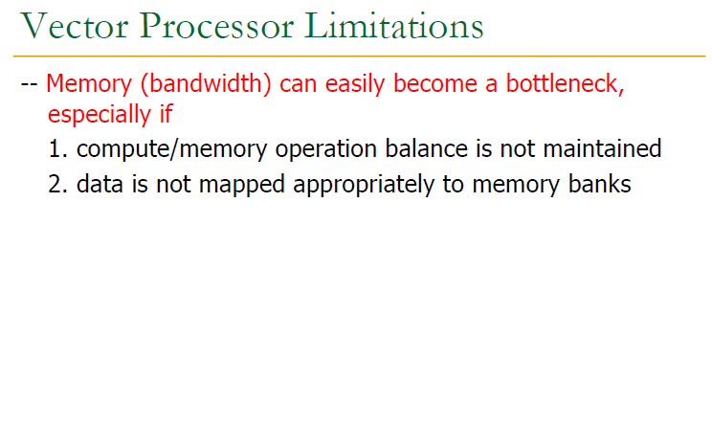

Slide 17


Slide 18
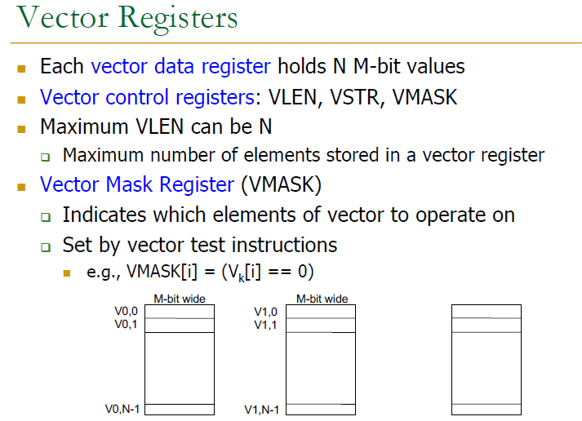

Slide 20
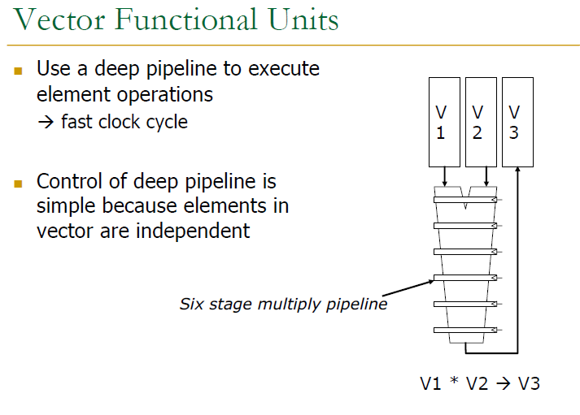

Slide 21
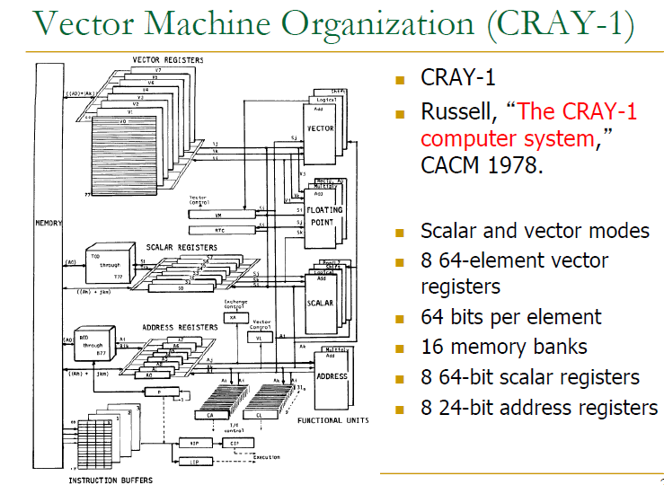

Slide 22
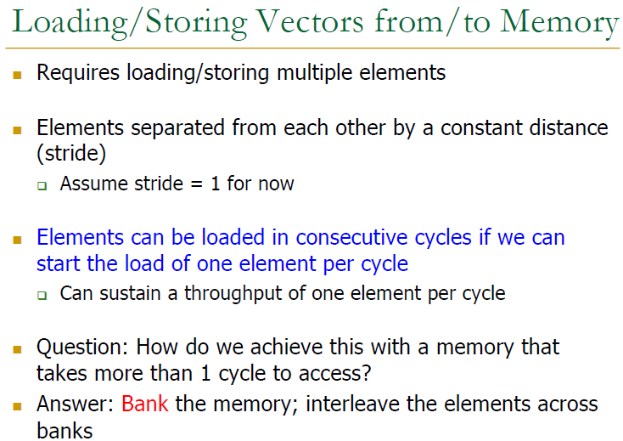

Slide 23
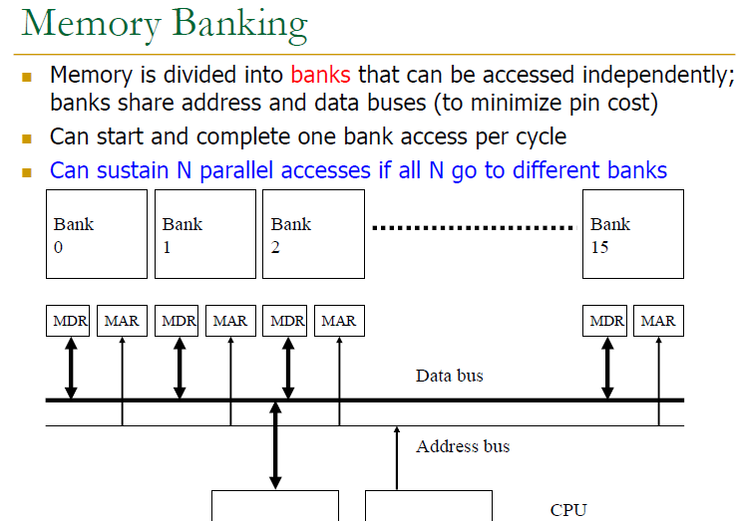

Slide 24
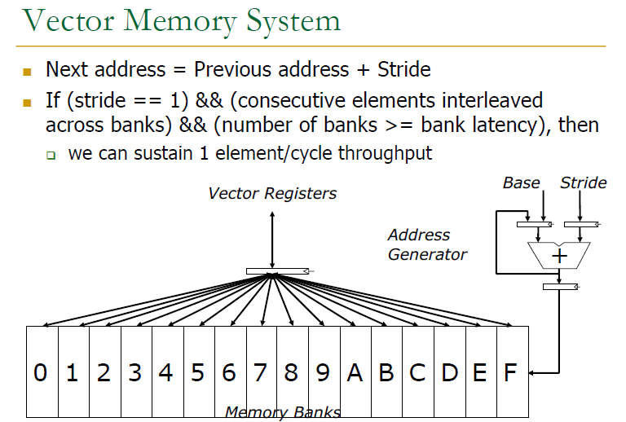

Slide 25
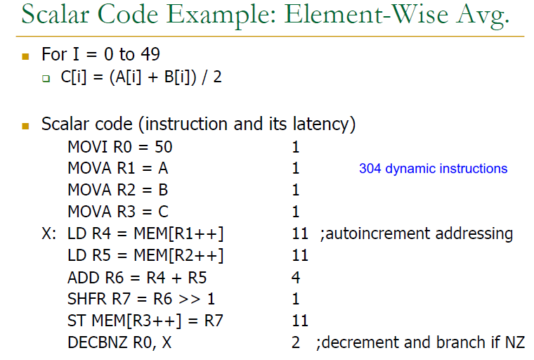

Slide 26
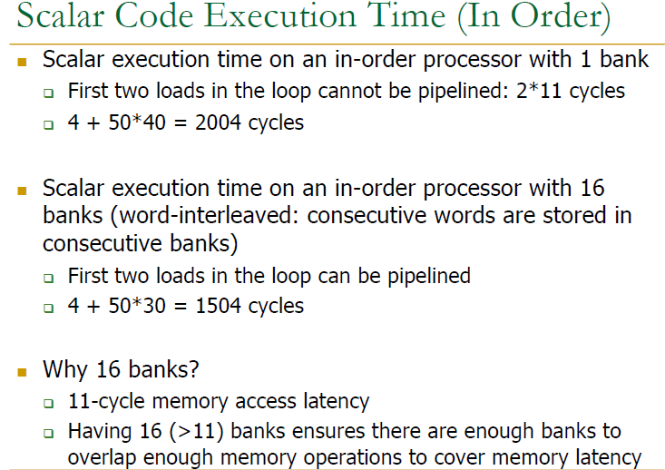

Slide 27
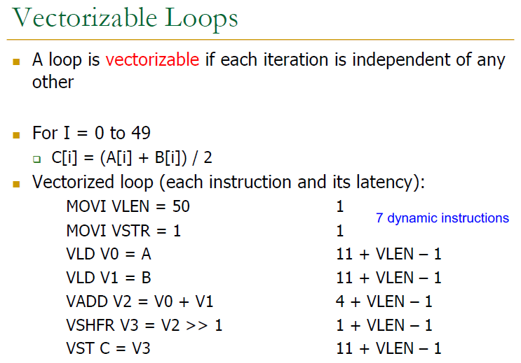

Slide 28
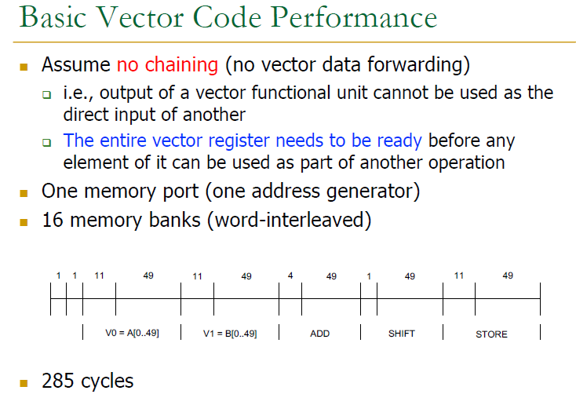

Slide 29
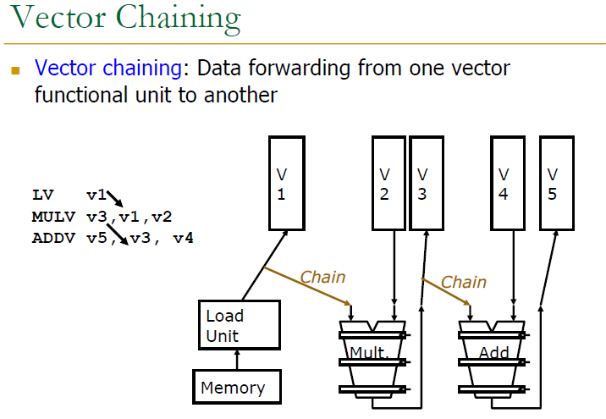

Slide 30
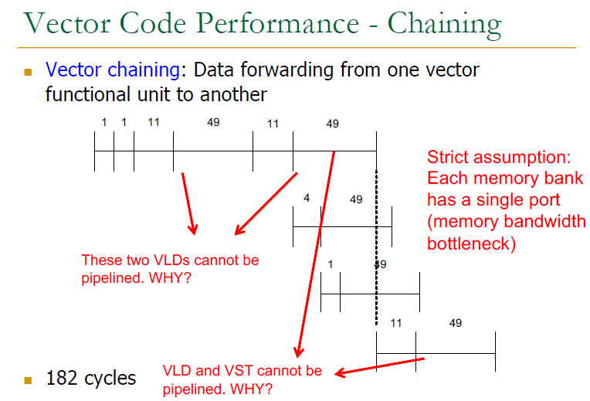

Slide 33
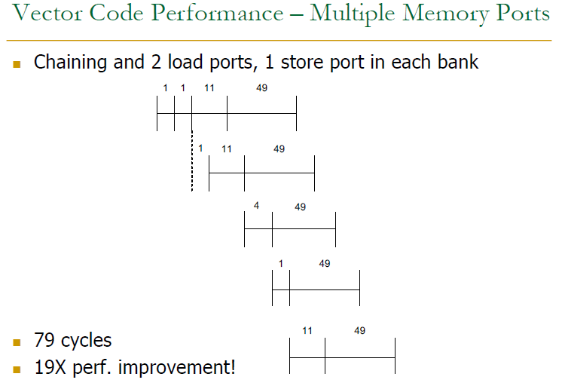

Slide 35
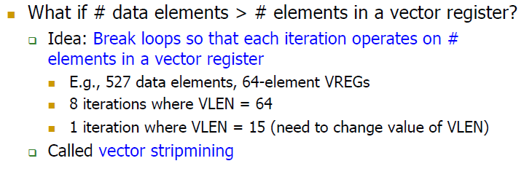

Slide 36
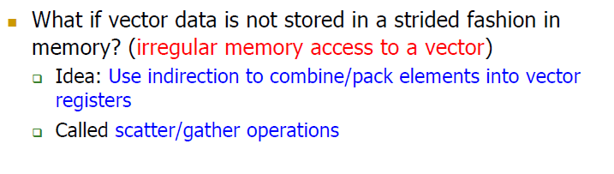

Slide 38
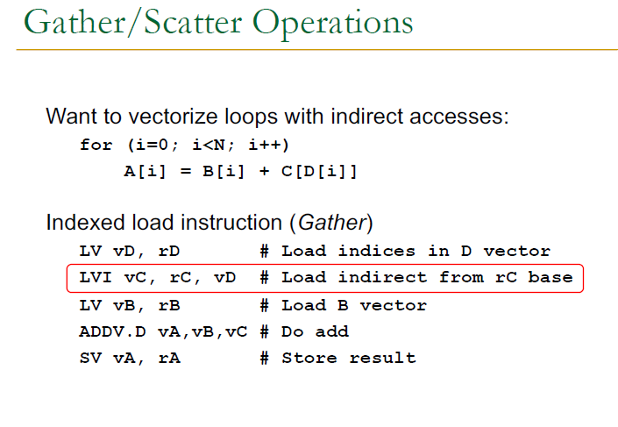

Slide 39
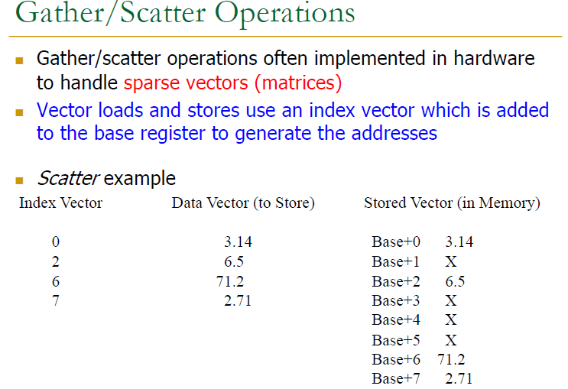

Slide 40
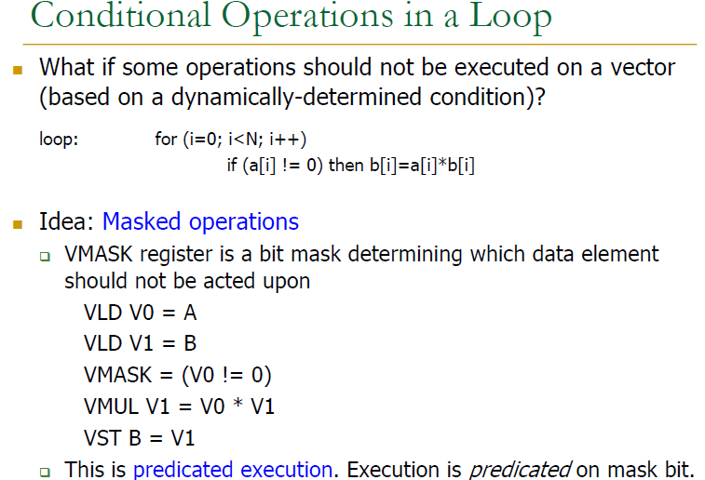

Slide 42
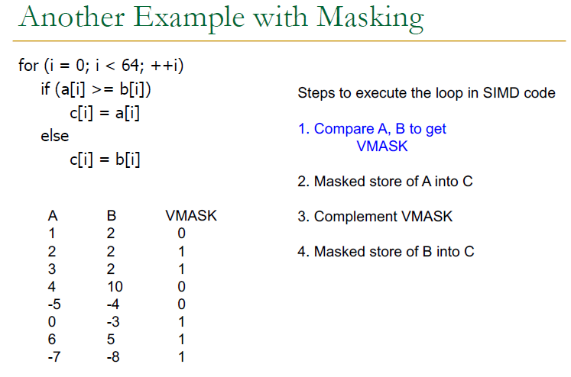

Slide 43
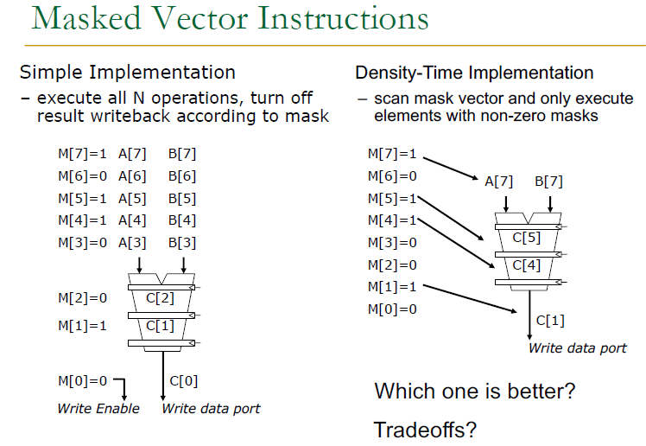

Slide 44
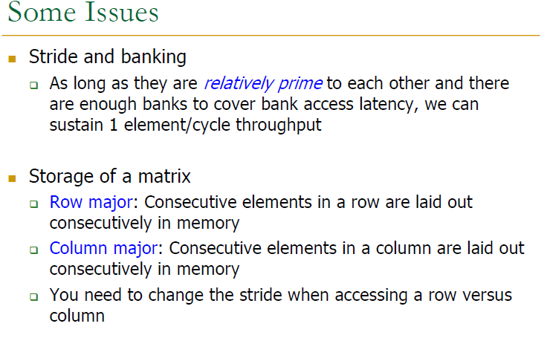

Slide 45
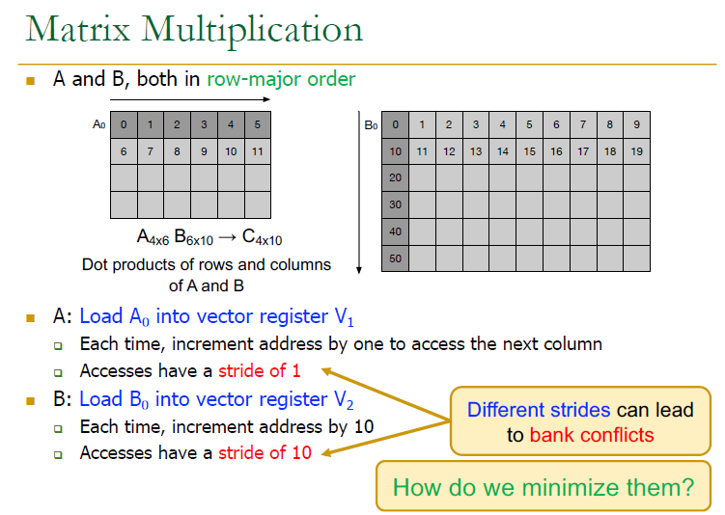

Slide 47
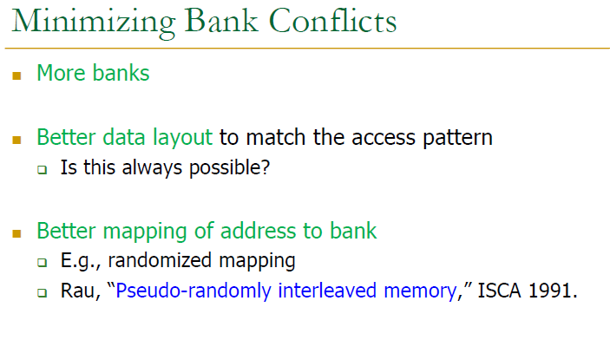

Slide 60
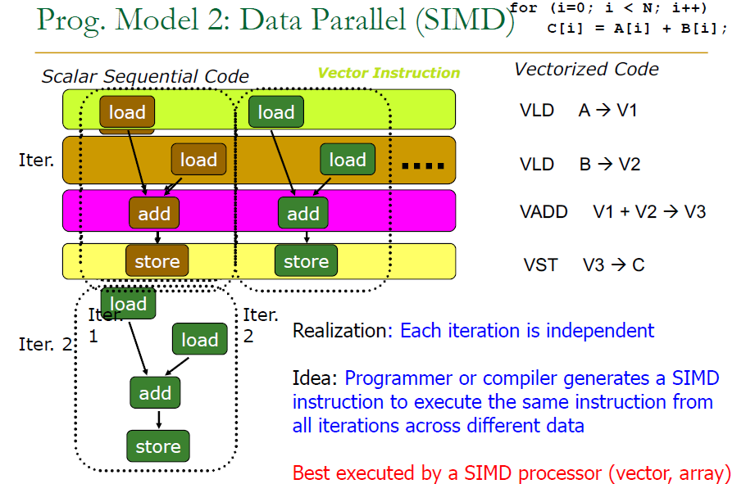

Slide 63
SIMD Processing/Vector Processing MMX/SSE/SSE2/SSE3/AVX etc.
MMX Instructions
MMX Registers
MM0
MM1
MM2
MM3
…….
MM8

Slide 64
SIMD Processing/Vector Processing MMX/SSE/SSE2/SSE3/AVX etc.
Flexible registers
Quadword
Double word
Word
Bytes

Slide 65
SIMD Processing/Vector Processing MMX/SSE/SSE2/SSE3/AVX etc. (Instruction Set)
movd operand 1 operand 2
movq operand 1 operand2

Slide 66
SIMD Processing/Vector Processing MMX/SSE/SSE2/SSE3/AVX etc. (Instruction Set)
paddb
paddsb

Slide 67
SIMD Processing/Vector Processing MMX/SSE/SSE2/SSE3/AVX etc. (Instruction Set)
paddusb
paddw
paddsw
paddusw
paddd

Slide 68
SIMD Processing/Vector Processing MMX/SSE/SSE2/SSE3/AVX etc. (Instruction Set)
psubb
psubsb
psubusb
psubw
psubsw

Slide 69
SIMD Processing/Vector Processing MMX/SSE/SSE2/SSE3/AVX etc. (Instruction Set)
psubusw
psubd

Slide 70
SIMD Processing/Vector Processing MMX/SSE/SSE2/SSE3/AVX etc. (Instruction Set)
pmulhw

Slide 71
SIMD Processing/Vector Processing MMX/SSE/SSE2/SSE3/AVX etc. (Instruction Set)
pmullw

Slide 72
SIMD Processing/Vector Processing MMX/SSE/SSE2/SSE3/AVX etc. (Instruction Set)
pmaddwd

Slide 73
SIMD Processing/Vector Processing MMX/SSE/SSE2/SSE3/AVX etc. (Instruction Set)
psllw

Slide 74
SIMD Processing/Vector Processing MMX/SSE/SSE2/SSE3/AVX etc. (Instruction Set)
pslld
psllq
psrlw
psrld
psrlq
psraw
psrad

Slide 75
SIMD Processing/Vector Processing MMX/SSE/SSE2/SSE3/AVX etc. (Instruction Set)
packssdw

Slide 76
SIMD Processing/Vector Processing MMX/SSE/SSE2/SSE3/AVX etc. (Instruction Set)
packsswb

Slide 77
SIMD Processing/Vector Processing MMX/SSE/SSE2/SSE3/AVX etc. (Instruction Set)
packuswb

Slide 78
SIMD Processing/Vector Processing MMX/SSE/SSE2/SSE3/AVX etc. (Instruction Set)
punpcklbw

Slide 79
SIMD Processing/Vector Processing MMX/SSE/SSE2/SSE3/AVX etc. (Instruction Set)
punpcklwd

Slide 80
SIMD Processing/Vector Processing MMX/SSE/SSE2/SSE3/AVX etc. (Instruction Set)
punpckldq

Slide 81
SIMD Processing/Vector Processing MMX/SSE/SSE2/SSE3/AVX etc. (Instruction Set)
punpckhbw

Slide 82
SIMD Processing/Vector Processing MMX/SSE/SSE2/SSE3/AVX etc. (Instruction Set)
pand
por
pxor
pandn

Slide 83
SIMD Processing/Vector Processing MMX/SSE/SSE2/SSE3/AVX etc. (Instruction Set)
e.g.
pxor mm7, mm7
punpcklbw mm0, mm7
e.g.
movq mm7, mm0
psraw mm7, 15
punpcklbw mm0, mm7

Slide 84
SIMD Processing/Vector Processing MMX/SSE/SSE2/SSE3/AVX etc. (Instruction Set)
e.g.
mov al, ‘A’
and eax, 0ffh
movd mm0, eax
punpcklqd mm0, mm0
packssdw mm0, mm0
packuswb mm0, mm0

Slide 87
SIMD Processing/Vector Processing MMX/SSE/SSE2/SSE3/AVX etc. (Instruction Set)
pcmpeqb
pcmpeqw
pcmpeqd
pcmpgtb
pcmpgtw
pcmpgtd

Slide 88
SIMD Processing/Vector Processing MMX/SSE/SSE2/SSE3/AVX etc. (Instruction Set)
e.g.
pcmpeqb mm6, mm7
e.g.
pcmpgtw mm5, mm6

Slide 89
SIMD Processing/Vector Processing MMX/SSE/SSE2/SSE3/AVX etc. (Instruction Set)
if (a[x]==b[x])
a[x]=100;
else
a[x]=0;

Slide 90
SIMD Processing/Vector Processing MMX/SSE/SSE2/SSE3/AVX etc. (Instruction Set)
mov rax, 100
movd mm7, eax
punpckldq mm7, mm7
packssdw mm7, mm7
packuswb mm7, mm7
movq mm0, qword ptr a
pcmpeqb mm0, qword ptr b
pand mmo, mm7
movq ptr a, mm0

